Slide 1
Finite Field Extensions and their applications
Tolga Gölbaşı

Slide 2
About Me
BSc in Mathematics with Computer Science on Ege University 2006-2011
MSc in Computer Engineering with Cyber Security on Yasar University 2012-

Slide 3
Objectives
Field
Finite Field(Galois Field)
Ideal
Quotient Ring
Field Extension
Magma applications
Multivariate Cryptography

Slide 4
Field
A field, denoted by F = <{...}, +, *> is a commutative ring in which the second operation satisfies all five properties defined for the first operation except that the identity of the first operation has no inverse with respect to the second operation.
+
*
  Closure
  Associativity
  Commutativity
  Existance of identity
  Existance of inverse
  Closure
  Associativity
  Commutativity
  Existence of identity
  Existance of inverse

Slide 5
Finite Fields
Finite Fields are Fields with a finite amount of elements. These are special types of sets that are algebraic systems that are closed under addition, subtraction, multiplication and division (except for 0).
Groups
Commutative Rings
Integral Domains
Fields

Slide 6
Finite Fields
Galois showed that for a field to be finite, the number of elements should be p^{n}, where p is a prime and n is a positive integer.
A Galois field, GF(p^{n}), is a finite field with p^{n} elements.

Slide 7
Properties of a Finite Field
It can be shown that finite fields have order p^{n}, where p is a prime
It can be shown that for each prime p and each positive integer n, there is, up to isomorphism, a unique finite field of order p^{n}.
It can be shown that for each positive integer n there exists an irreducible polynomial of degree n over GF(p) for any p.
It can be shown that for each divisor m of n, GF(p^{n}) has a unique subfield of order p^{m}. Moreover, these are the only subfields of GF(p^{n}).

Slide 8
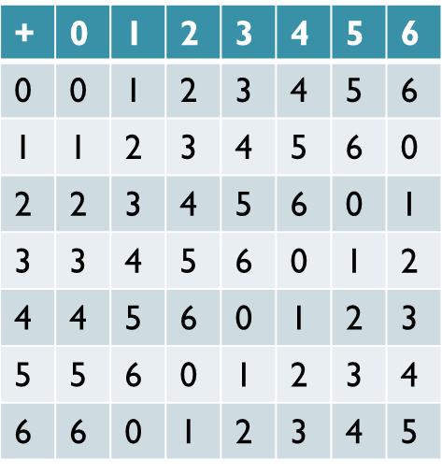
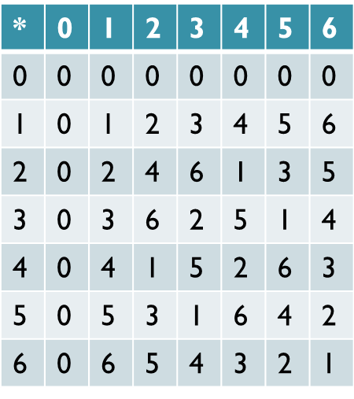
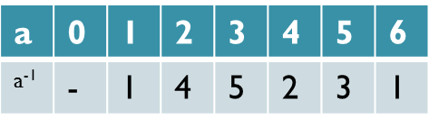
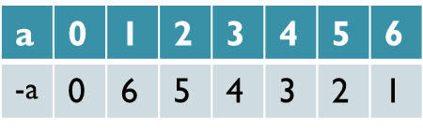
GF(p) Fields
For every prime p, Z_{p}, the ring of integers modulo p, is a field
Example: GF(7)

Slide 9
Polynomials
Let R[x] represent the ring of polynomials over R.
  You can add and multiply polynomials just like you have always done but the coefficent arithmetic is done over R.
    If R=Z₇ then 5x+3x=x, (4x²)(5x⁷)=6x⁹
Let p(x) R[x].
  If p(x) = a_{n}x_{n} + a_{n-1}x^{n-1} + ... + a₁x + a₀ where a_{n} ≠ 0 , then deg(p(x)) = n.
To construct GF(p^{n}), first find an irreducible polynomial I of degree n, with coefficients in Z_{p}.
  Let GF(p^{n}) = {a_{n-1}x^{n-1} + a_{n-2}x^{n-2} + ... + a₁x + a₀ | a_{i} Z_{p}} (Note that here addition is done modulo Z_{p} while multiplication is done modulo I)

Slide 10




Polynomials
Figure below show how to represent 8-bit word using Z₂ polynomials.
8-bit word
Polynomial
First simplification
Second simplification

Slide 11
Recall: Ideal
A non-empty subset I of a ring R is called an ideal of R if for all x and y elements of I and r element of R
  x – y is element of I.
  x * r and r * x are elements of I.
For example, nZ consisting of all integer multiples of n, is an ideal generated by n in Z.

Slide 12
Recall:Quotient Ring
Let I be an ideal in the ring R. Then the set of cosets forms a ring (R/I, +, *) under the operations defined by
(I + r₁) + (I + r₂) = I + (r₁ + r₂)
And
(I + r₁)*(I + r₂) = I + (r₁ * r₂).
This ring (R/I,+ , *) is called the quotient ring(factor ring) of R by I
We can use quotient rings when constructing field extensions.

Slide 13
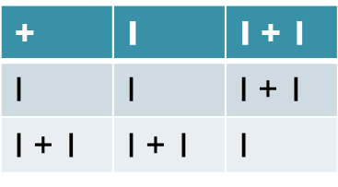
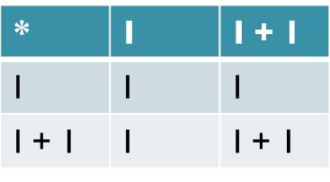
Quotient Ring example
Quotient Ring Z₆/{0,2,4}
There are two cosets of Z₆ by I
I = {0,2,4} and I + 1 = {1,3,5} then
Z₆/{0,2,4} = {I,I+1}

Slide 14
Quotient Ring of Polynomial Ring Example
Z₂[x] denotes ring of polynomials with coefficients in Z₂.
The constant polynomials are 0 and 1.
The polynomials of degree 1 are x and x + 1.
The polynomials of degree 2 are x², x² + 1, x² + x, x² + x + 1.
The set <x²+x+1> consists of all multiples of x²+x+1. some elements of <x²+x+1> are
  x(x²+x+1)= x³+x²+x, (x + 1)(x² +x+ 1)= x³ +1, (x²+1)(x²+x+1)=x⁴+x³ + x +1
We can show that <x²+x+1> is an ideal in Z₂[x].

Slide 15
Example continued
Let’s form the quotient ring Z₂/<x²+x+1>. Cosets look like f(x)+<x²+x+1>.
Some cosets: 0+<x²+x+1>, (x⁵⁷+x³+1)+<x²+x+1>, (x+1)+<x²+x+1>.
We can add and multiply cosets by adding and multiplying representatives
  [(x²+x+1)+<x²+x+1>]+[(x²+1)+<x²+x+1>]=x+<x²+x+1>
  [(x+1)+<x²+x+1>]*[(x²+1)+<x²+x+1>]= (x³+x²+x+1)+<x²+x+1>
Multiples of x²+x+1 equal to 0 in quotient ring.
If our polynomial is an irreducible polynomial and Our polynomial ring is generated from a field then this quotient ring is actually a new field which is called extension field.

Slide 16
Extend the Extension
x²+x+1 polynomial was actually irreducible thus Z₂/<x²+x+1> is a field.
Let’s extend our new field F=Z₂/<x²+x+1> with degree 3 irreducible polynomial F[t]/<(x+1)*t³+(x²+x+1)*t²+(x²+x)>
Let’s say I=<(x+1)*t³+(x²+x+1)*t²+(x²+x)>
We can generate quotient ring with this ideal I some elements of this quotient ring are:
  0 + I
  t² + I
  (x+1)*t²+x*t + I

Slide 17
Field Extension
A field K is said to be an extension field, denoted K / F, of a field F if F is a subfield of K.
For example the complex numbers are an extension field of the real numbers, and the real numbers are an extension field of the rational numbers.

Slide 18
Finite extension vs simple extension
Finite extension is a field extension that is dimensionally finite while field can have infinite cardinality.
Simple extension is a field extension of a finite field.

Slide 19
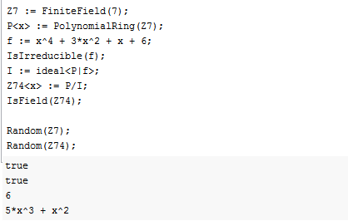
MAGMA Example

Slide 20
Post-Quantum Cryptography
If large enough quantum computers built integer factorization problem and discrete logarithm problem can be solveable in reasonable times. These problems are backbone of some popular cryptosystems.
Post-Quantum Cryptography focuses on quantum computer resistant cryptosystems. Some of them are:
  Lattice-based cryptography
  Multivarite cryptography(based on multivariate polynomials over finite fields or extension fields.)
  Hash-based signatures
  Code-based cryptography

Slide 21
Multivariate cryptography
Solving systems of multivariate polynomial equations proven to be NP-Hard or NP-Complete.
Shamir-Schnorr-Ong (1984)
Imair-Matsumoto’s C*(1988)
Shamir’s Birational Permutation Schemes (1993)
Oil and Vinegar (1997)
QUARTZ (2000)
FLASH / SFLASH (2000)
TTS – Tame Transformation Signature
All attempts to build a secure encryption scheme have so far failed.

Slide 22
Thank You For Listening

